Slide 1

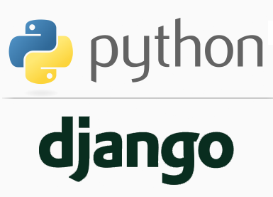
FULL STACK WEB DEVELOPMENT WITH DJANGO
Lecture 2

Slide 2

Today’s Agenda
Understanding Django’s Architecture
Architecture Of Django
Recap Of MVC
Django’s MVT

Slide 3
Django Architecture
Django uses MVT (Model-View-Template)architecture which is inspired by the famous MVC (Model-View-Controller) architecture used for developing software applications.
So before we can understand Django’s architecure , we must first recall MVC architecture

Slide 4
Recap Of MVC
MVC divides the app into three different parts:
The Model is the logical data structure behind the entire application and is represented by a database(generally relational databases such as MySql, Oracle, Sqlite etc).
The View is the user interface — what you see in your browser when you visit a website. These are represented by HTML/CSS/Javascript files.
The Controller is the middleman that connects the View and Model together, meaning that it is the one passing data from the Model to the View.

Slide 5
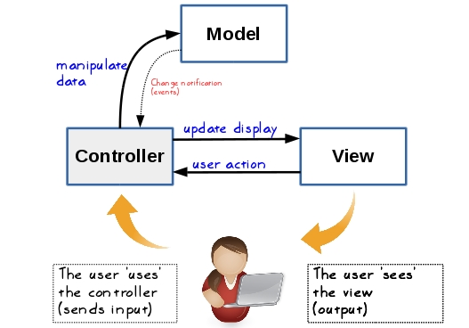
Recap Of MVC

Slide 6
Recap Of MVC
Here is a rundown of steps involved in an MVC blog application.
Web browser or client sends the request to the web server, asking the server to display a blog post.
The request received by the server is passed to the controller of the application.
The controller asks the model to fetch the blog post.
The model sends the blog post to the controller.
The controller then passes the blog post data to the view.
The view uses blog post data to create an HTML page and sends the response to the client

Slide 7
Django’s MVT
The Model-View-Template (MVT) is slightly different from MVC.
In fact the main difference between the two patterns is that Django itself takes care of the Controller part and hence the MVT nomenclature does not emphasize it

Slide 8
Django’s MVT Pattern
The components of MVT architecture as are follows:
Model - Data access layer. This deals with access, validation and relationships among data. Models are Python classes that mediate between Django ORM and the database tables.
Template - Presentation layer. This deals with how data is displayed to the client.
View - Business logic layer. This is a bridge between models and templates. A view accesses model data and redirects it to a template for presentation. Unlike the definition of a view in traditional MVC architecture, a Django view describes which data you see, not how you see it. It's about processing, not presentation.

Slide 9
Django’s MVT Pattern
Thus in Django , the Model remains same as the regular MVC , but the Views and Controllers are different.
The View in Django plays the role of Controller and Template in Django plays the role of View.

Slide 10
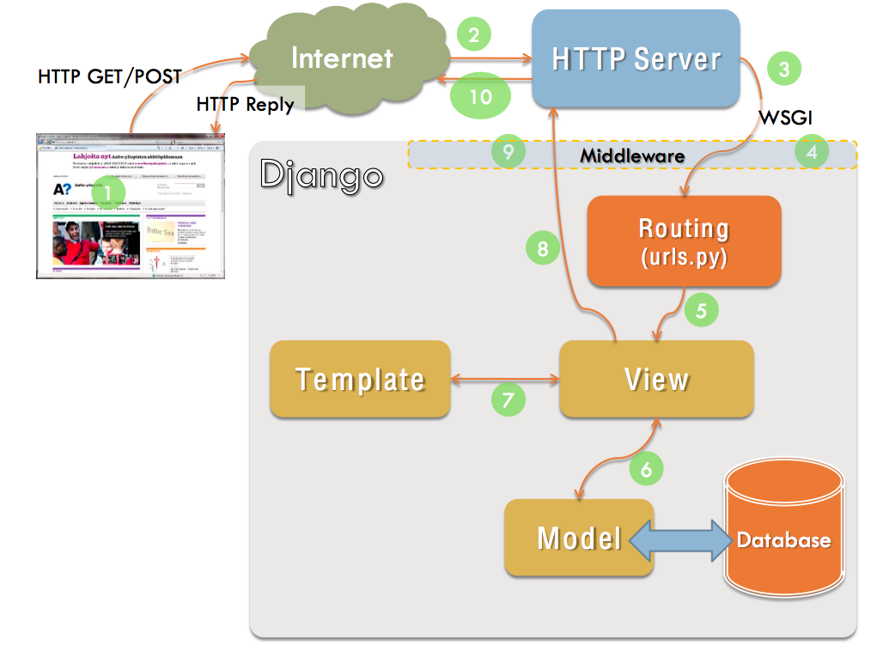
Django’s MVT Pattern

Slide 11
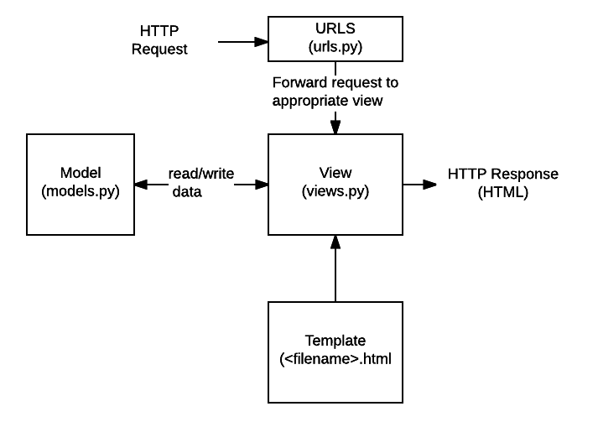
Django’s MVT Pattern

Slide 12
Description Of Each File
URLs: It is called the URL mapper and is used to redirect HTTP requests to the appropriate view based on the request URL.
View: A view is a request handler function, which receives HTTP requests and returns HTTP responses. Views access the data needed to satisfy requests via models, and delegate the formatting of the response to templates.

Slide 13
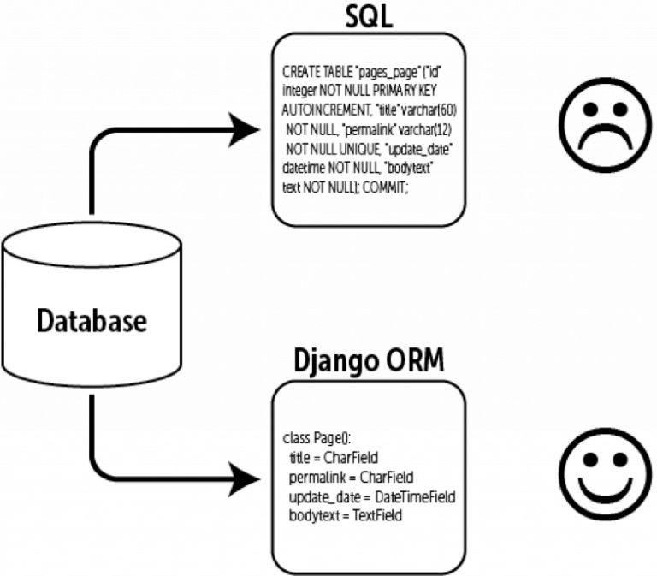
Description Of Each File
Models: Models are Python objects that provide mechanisms to manage (add, modify, delete and query )records in the database. Django’s model makes use of a powerful ORM layer which simplifies dealing with the database and accelerates the development process.

Slide 14
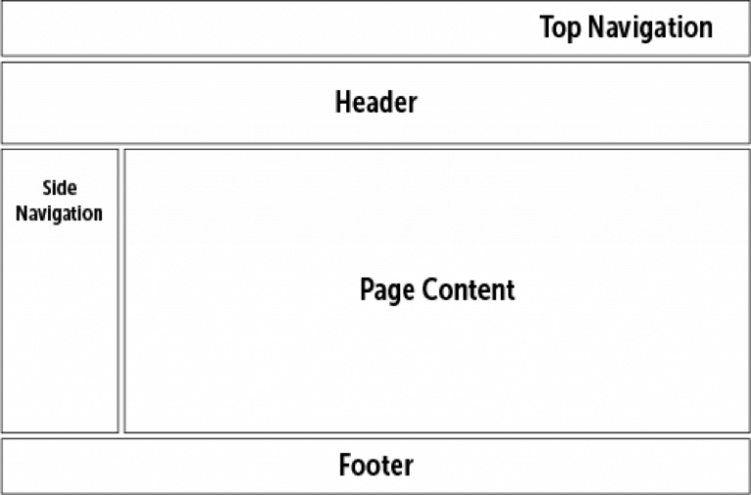
Description Of Each File
Templates: A template is a text file defining the layout of the page (such as an HTML page), with placeholders used to represent actual content. A view can dynamically create an HTML page using an HTML template, populating it with data from model.

